Slide 1

SAS Optimization Challenge 2023

Slide 2
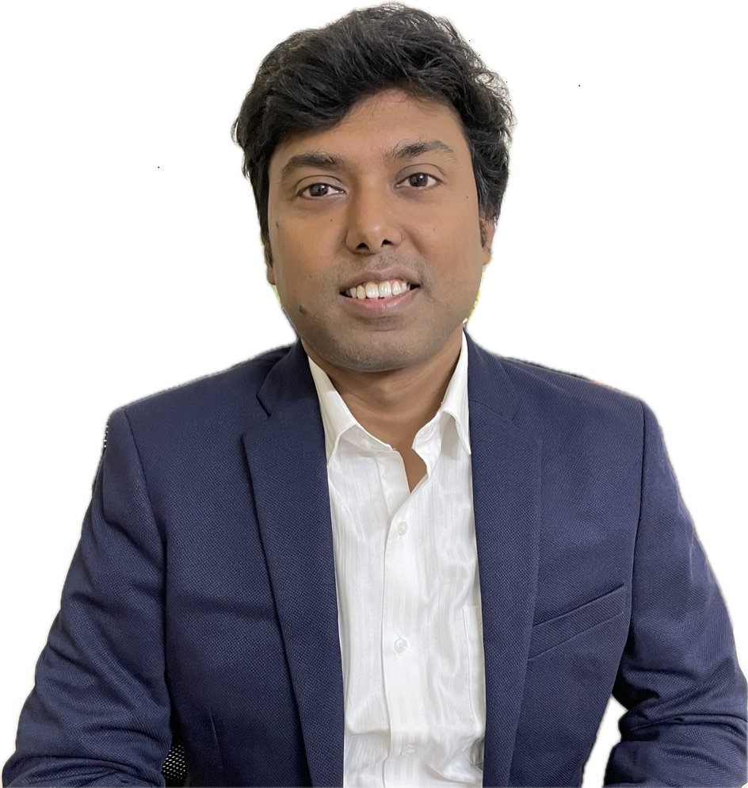

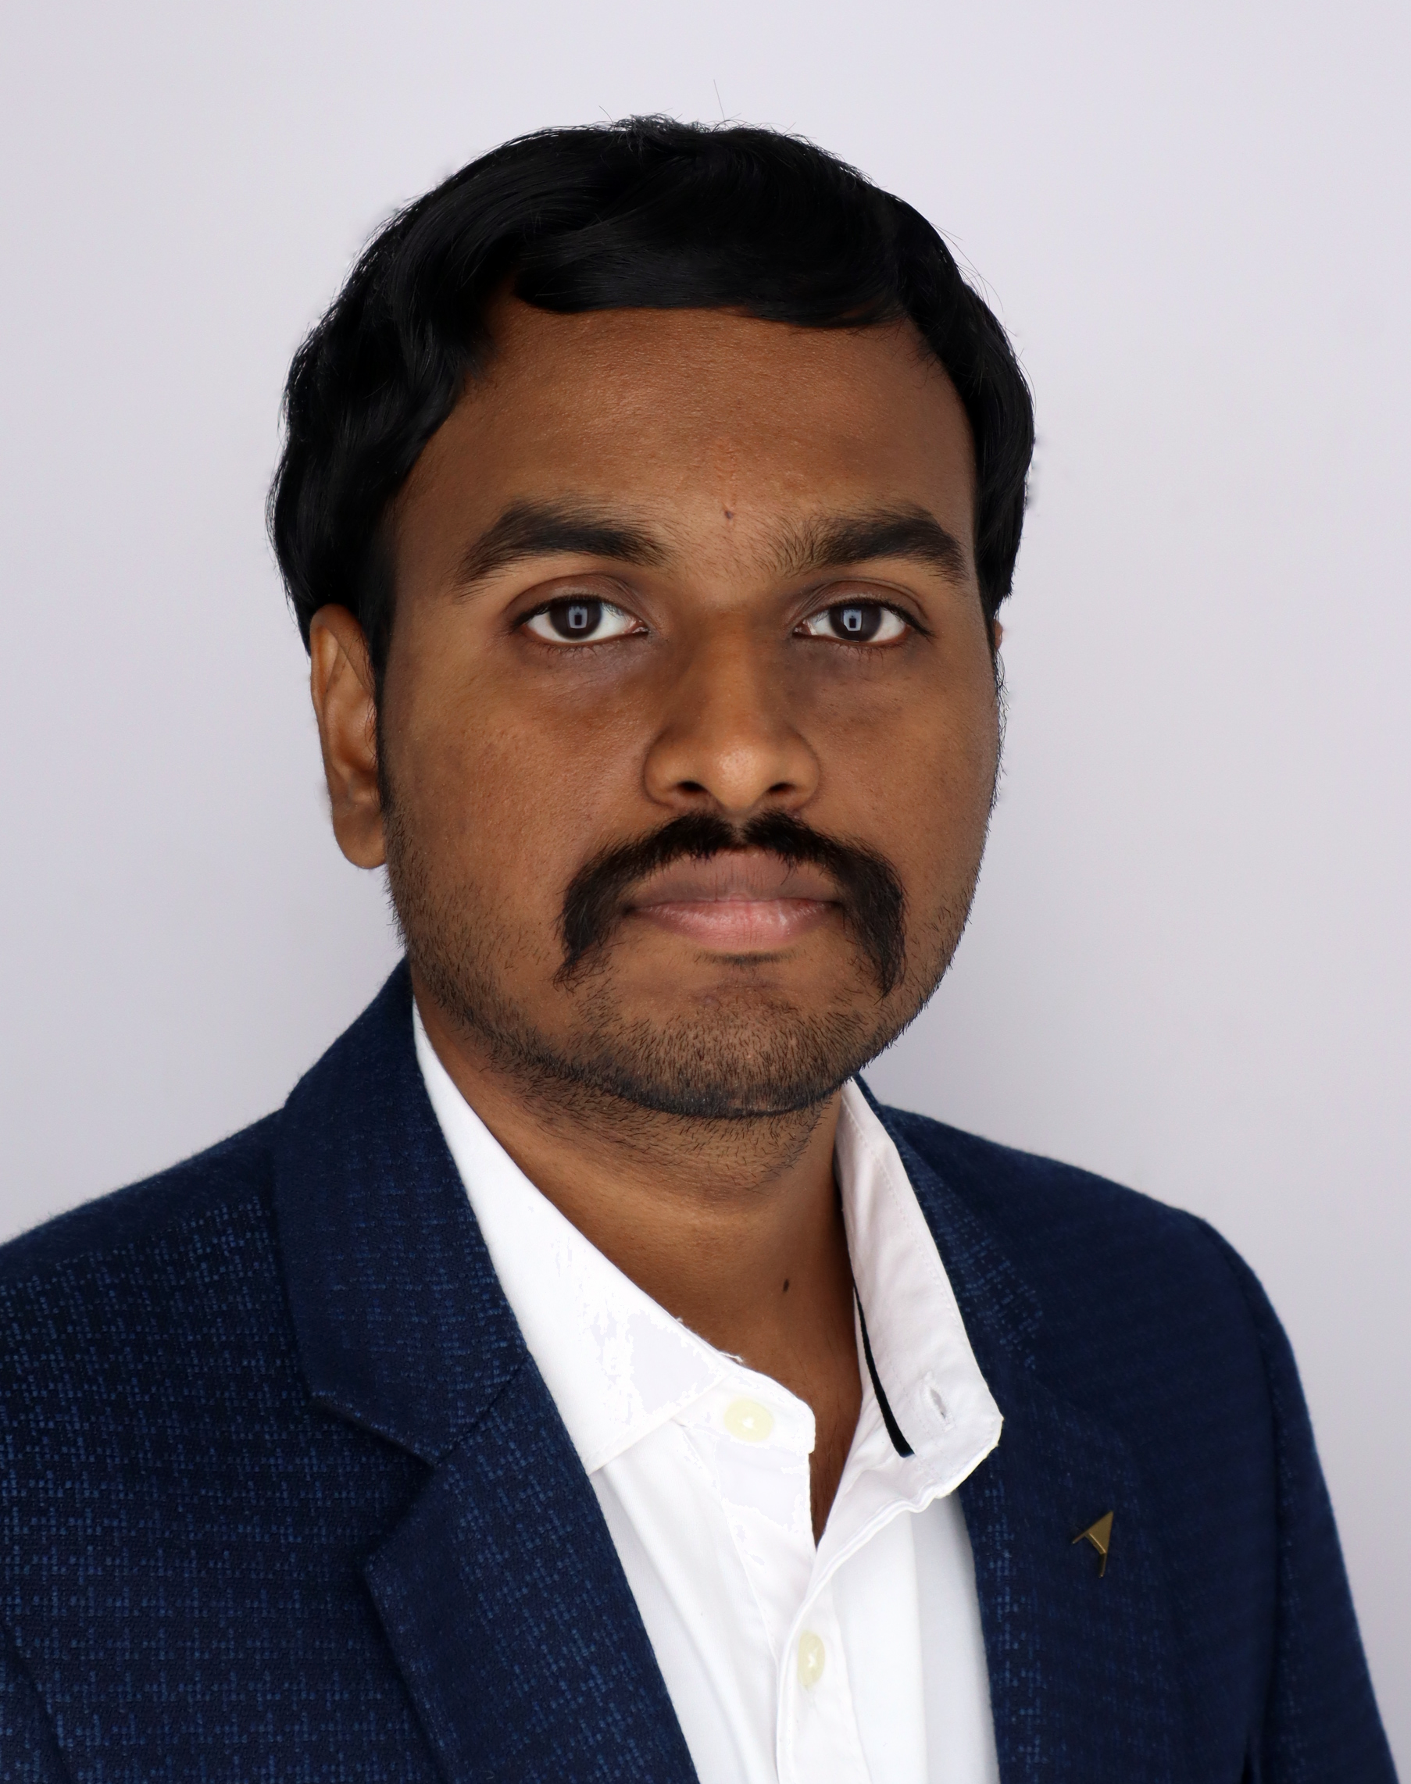

1
Our Team
Avishek Dasgupta
Kavyasri Jadala
Vineeth Pydi
Abhishek Krovvidi

Slide 3
1
Agenda
1
Problem Statement
2
Tier 1 Objective & Output
3
Tier 2 Objective & Output
4
Tier 3 Objective & Output
5
Tier 4 Objective & Output
6
Tier 5 Objective & Output
7
Conclusion & Future Learning Opportunities

Slide 4




1
Problem Statement
The Operations Research professor needs help in crafting a challenging final exam to prepare his students to be successful Data Scientists upon graduation.
However, there is lack of time to develop both the curriculum and the final exam for his upcoming course.
The task for the team is to use SAS optimization techniques to develop the final exam based on certain constraints.
The final exam needs to contain fifty (50) questions from a large question bank developed and maintained by your professor over the years. The question bank currently contains one hundred and fifty-four (154) questions.
Data Sets provided
Question Bank containing
154 Questions
Objective questions defining how many questions from each topic objectives needs to be covered
8 pre-selected questions that must appear in the final exam

Slide 5

1
Tier 1
Objective
Choose fifty (50) questions that produces the most difficult exam possible from the 154-question question bank, while ensuring that each topic objective contains the desired number of questions
Objective Function
Constraints
Ensure each topic objective contains the desired number of questions
Only 50 questions should be selected
Maximize Total_Difficulty of the exam where difficulty is defined as (1-Correct)

Slide 6
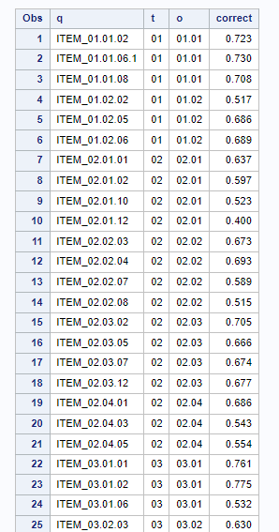
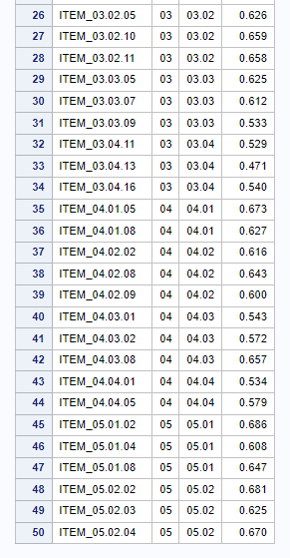
Tier 1 : Output
1
Average Correct = 0.62194

Slide 7
1
Tier 2
Objective
Choose fifty (50) questions that produce the most difficult exam possible, while ensuring that each topic objective contains the correct number of questions, as well as ensuring that no more than one question in each frenemy group is assigned to the exam
Objective Function
Constraints
Ensure each topic objective contains the desired number of questions
Ensure no more than one question in each frenemy group is assigned
Only 50 questions should be selected
Maximize Total_Difficulty of the exam where difficulty is defined as (1-Correct)

Slide 8
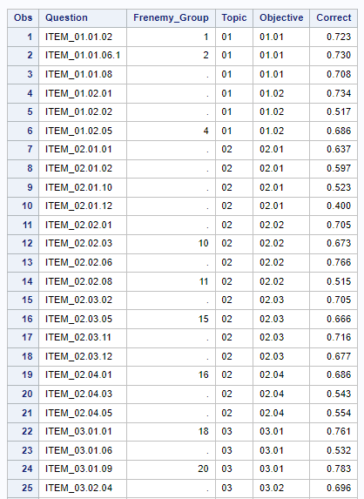
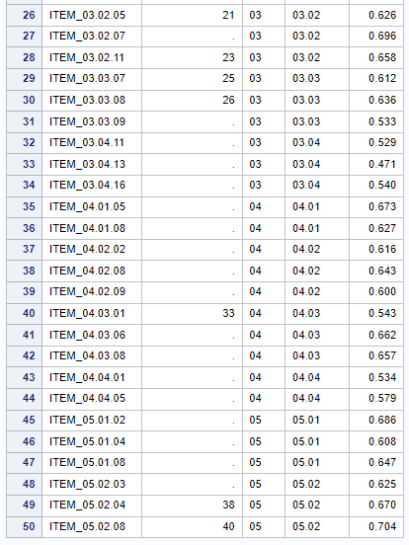
Tier 2 : Output
1
Average Correct = 0.63216

Slide 9
1
Tier 3
Objective
Choose fifty (50) questions that produce the most difficult exam possible, while ensuring that each topic objective contains the correct number of questions, ensuring that no more than one question in each frenemy group is assigned to the exam, and ensuring that eight (8) pre-selected questions must be on the final exam
Objective Function
Constraints
Maximize Total_Difficulty of the exam where difficulty is defined as (1-Correct)
Ensure each topic objective contains the desired number of questions
Ensure no more than one question in each frenemy group is assigned
Only 50 questions should be selected
Condition
Force the inclusion of the eight specified questions

Slide 10
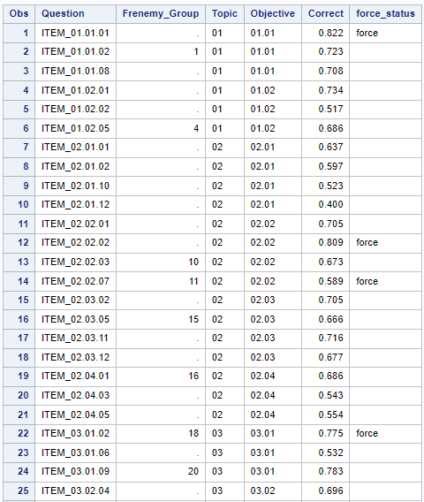
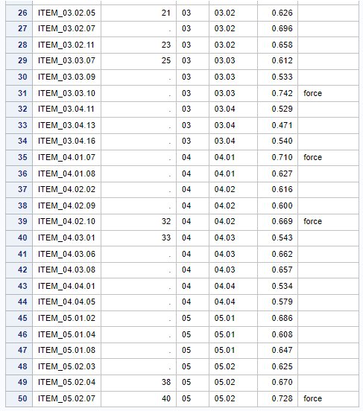
Tier 3 : Output
1
Average Correct = 0.64048

Slide 11
1
Tier 4
Objective
Find the two most difficult, balanced exams from the question bank, while ensuring the following requirements are satisfied for each exam:
I. Each topic objective contains the correct number of questions for each exam.
II. No more than one question from each frenemy group is assigned to an exam.
III. The same question cannot appear on both exams.
IV. The eight (8) questions forced into the Tier 3 final exam must be forced into the Live exam
Objective Function
Constraints
Minimize the absolute value of the difference in difficulty between the Practice and Live exams.
Ensure each topic objective contains the desired number of questions
Ensure no more than one question in each frenemy group is assigned
Only 50 questions should be selected in each exam
Ensure same questions does not appear in both exams
Condition
Force the inclusion of the eight specified questions in “Live” Exam

Slide 12
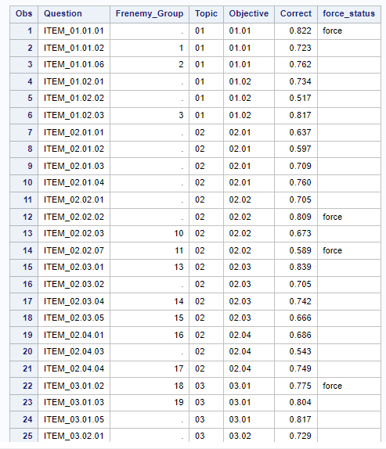
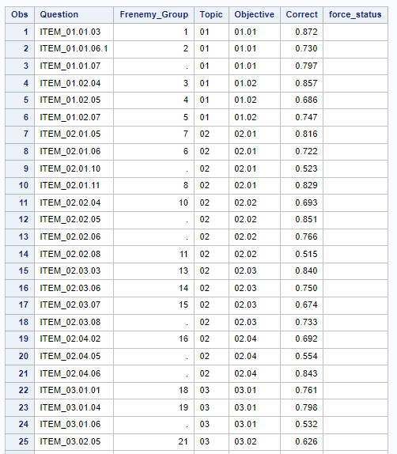
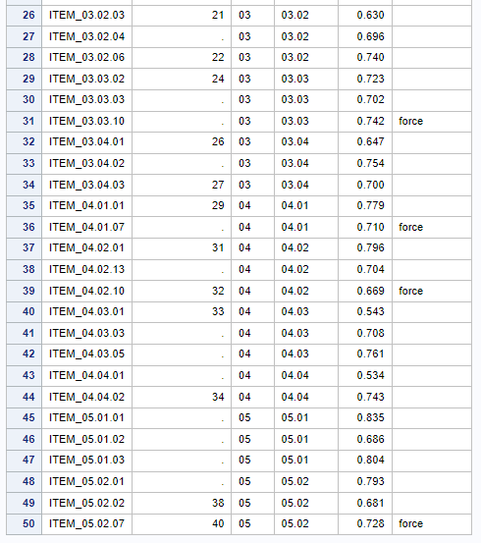
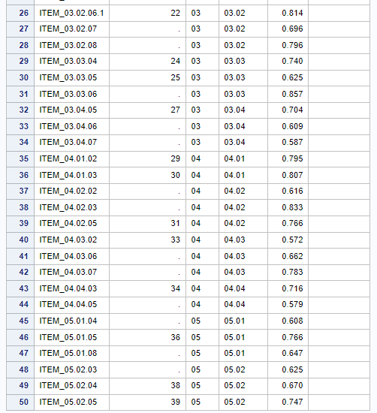
Tier 4 : Output
1
AverageCorrect_Live = 0.71434, AverageCorrect_Practice = 0.71654
Live Exam
Practice Exam

Slide 13
1
Tier 5
Objective
Find the two most difficult, balanced exams from the question bank, while ensuring the following requirements are satisfied for each exam:
I. Each topic objective contains the correct number of questions for each exam.
II. No more than one question from each frenemy group is assigned to an exam.
III. The eight (8) questions forced into the Tier 3 final exam must be forced into the Live exam
IV. Between 10% and 20% of exam questions are contained in both the Practice and Live exams
Objective Function
Constraints
Minimize the absolute value of the difference in difficulty between the Practice and Live exams.
Ensure each topic objective contains the desired number of questions
Ensure no more than one question in each frenemy group is assigned
Only 50 questions should be selected in each exam
Between 10% and 20% of exam questions are contained in both the exams
Condition
Force the inclusion of the eight specified questions in “Live” Exam

Slide 14
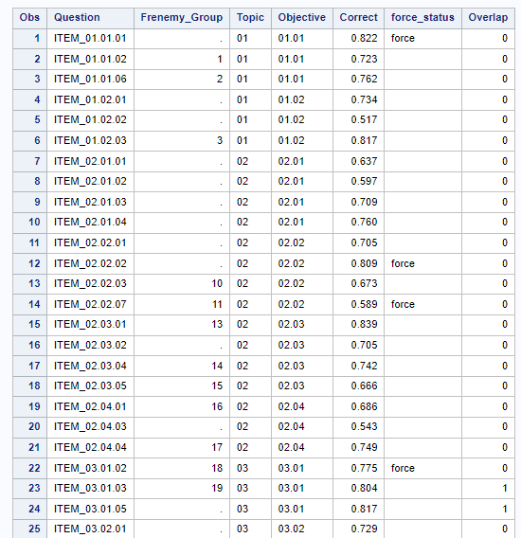
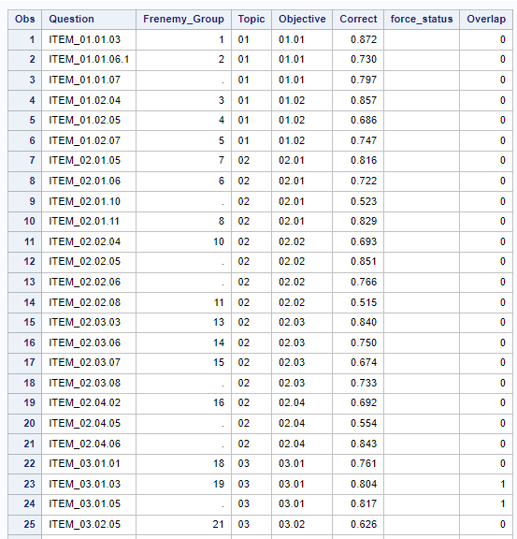
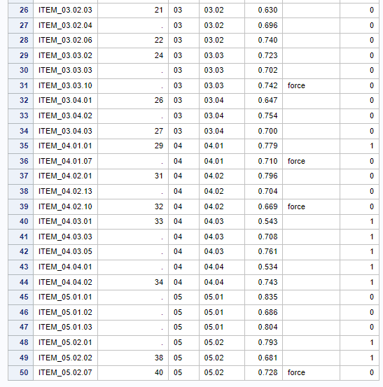
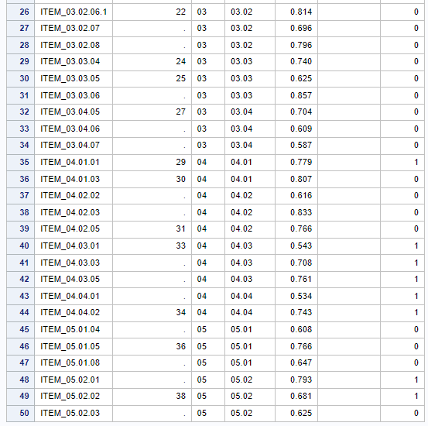
Tier 5 : Output
1
AverageCorrect_Live = 0.71434, AverageCorrect_Practice = 0.72272
Live Exam
Practice Exam

Slide 15
Conclusion & Future learning Opportunities
1
In conclusion, we can say that, in Tier 1, we designed the most difficult exam subject to the objective constraint and as we introduced more constraints in subsequent tiers, the exam difficulty level was reduced that is it became easier. In Tier 4 & 5, we attempted to create 2 balanced exam in terms of difficulty and tried to identify the most difficult balanced exams using SAS optimization, due to which the overall difficulty of the exams were further reduced.
The optimization technique used in the exercise can be adapted and applied to various real-world business problems:
Inventory Management: Optimize inventory levels in a supply chain network to balance service levels and costs. Ensure that each location has the required stock of products while minimizing holding costs and backorders.
Production Scheduling: Optimize the production schedule in a manufacturing facility to meet demand while minimizing production costs and overtime. Ensure that each product is produced in the right quantity and at the right time.
Resource Allocation: Allocate resources (e.g., personnel, equipment, funds) to projects or tasks to maximize project success while minimizing costs. Ensure that each project receives the necessary resources.
Portfolio Optimization: Optimize an investment portfolio to maximize returns while managing risk. Ensure that each asset is allocated appropriately within the portfolio.
Supply Chain Network Design: Optimize the design of a supply chain network to minimize transportation costs while meeting customer demand. Ensure that each distribution center is located optimally and serves the right set of customers.
Route Planning and Delivery Optimization: Optimize the routing of delivery vehicles to minimize transportation costs and delivery times. Ensure that each delivery is made on time and cost-effectively.

Slide 16
Video Presentation Link
1
https://youtu.be/xGzxqEZksg4

Slide 17

Thank You

